Slide 1
UNIT - III
CPU control unit design: Instruction Codes - Computer Registers - Computer Instructions - Timing and Control - Instruction Cycle - Memory-Reference Instructions - Input-Output and Interrupt - Design of Basic Computer - Design of Accumulator Logic.
Microprogrammed Control: Control Memory - Address Sequencing- Microprogram Example - Design of Control Unit. Pipelining: Basic Concept - Pipeline Organization - Pipelining Issues – Data Dependencies - Memory Delays- Branch Delays - Superscalar Operation - Pipelining in CISC Processors.
Parallel Processors: Hardware Multithreading - Vector (SIMD) Processing - Cache Coherence
Course Code: CS E212
Semester: III

Slide 2
Course Code: CS E212
Semester: III
CPU control unit design

Slide 3
There are two major types of control organization: hardwired control and microprogrammed control.
In the hardwired organization, the control logic is implemented with gates, flip-flops, decoders, and other digital circuits. It has the advantage that it can be optimized to produce a fast mode of operation.
A hardwired control, as the name implies, requires changes in the wiring among the various components if the design has to be modified or changed.
In the microprogrammed organization, the control information is stored in a control memory. The control memory is programmed to initiate the required sequence of microoperations.
In the microprogrammed control, any required changes or modifications can be done by updating the microprogram in control memory.
Course Code: CS E212
Semester: III

Slide 4
Instruction Codes
User of a computer can control the process by means of a program.
A program is a set of instructions that specify the operations, operands, and the processing sequence.
A computer instruction is a binary code that specifies a sequence of micro-operations for the computer.
Each computer has its unique instruction set. Instruction codes and data are stored in memory.
Computer reads each instruction from memory and places it in a control register
Control unit interprets the binary code of the instruction and proceeds to execute it by issuing a sequence of micro-operations
Course Code: CS E212
Semester: III

Slide 5
Course Code: CS E212
Semester: III
Instruction code is a group of bits that instructs the computer to perform a specific operation (sequence of microoperations).
Operation code of an instruction is a group of bits that defines certain operations such as add, subtract, shift, and complement.
Number of bits required for the operation code depends on the total number of operations available in the computer
2^{n} (or little less) distinct operations → n bit operation code

Slide 6
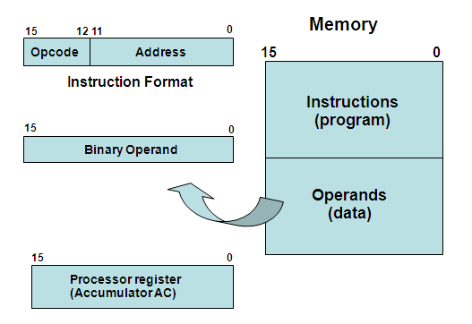
Stored Program Organization
Instruction code is usually divided into operation code, operand address, addressing mode, etc.
Simplest way to organize a computer is to have one processor register (accumulator AC) and an instruction code format with two parts (op code, address)
Course Code: CS E212
Semester: III

Slide 7
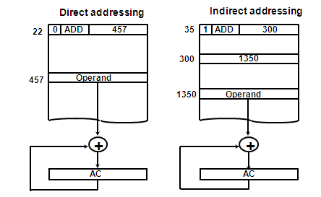
ADDRESSING MODES
Direct address: the address in memory of the data to use (the address of the operand)
Indirect address: the address in memory of the address in memory of the data to use
Course Code: CS E212
Semester: III

Slide 8
COMPUTER REGISTERS
Processor has many registers to hold instructions, addresses, data, etc
Processor has a register, the Program Counter (PC) that holds the memory address of the next instruction
Since the memory in the Basic Computer only has 4096 locations, the PC only needs 12 bits
In a direct or indirect addressing, the processor needs to keep track of what locations in memory it is addressing: The Address Register (AR) is used for this and the AR is a 12 bit register in the Basic Computer
When an operand is found, using either direct or indirect addressing, it is placed in the Data Register (DR). The processor then uses this value as data for its operation
Basic Computer has a single general purpose register – the Accumulator (AC)
Course Code: CS E212
Semester: III

Slide 9
The significance of a general purpose register is that it can be used for loading operands and storing results
  e.g. load AC with the contents of a specific memory location; store the contents of AC into a specified memory location
Often a processor will need a scratch register to store intermediate results or other temporary data; in the Basic Computer this is the Temporary Register (TR)
Basic Computer uses a very simple model of input/output (I/O) operations
Input devices are considered to send 8 bits of character data to the processor
The processor can send 8 bits of character data to output devices
Input Register (INPR) holds an 8 bit character gotten from an input device
Output Register (OUTR) holds an 8 bit character to be send to an output device
Course Code: CS E212
Semester: III

Slide 10
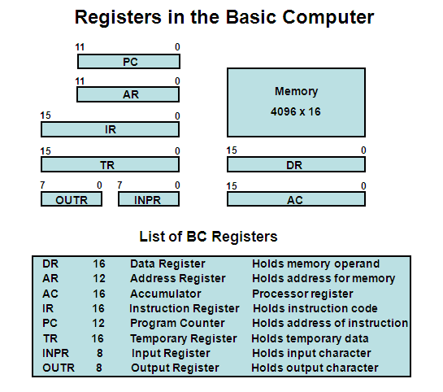
Course Code: CS E212
Semester: III

Slide 11
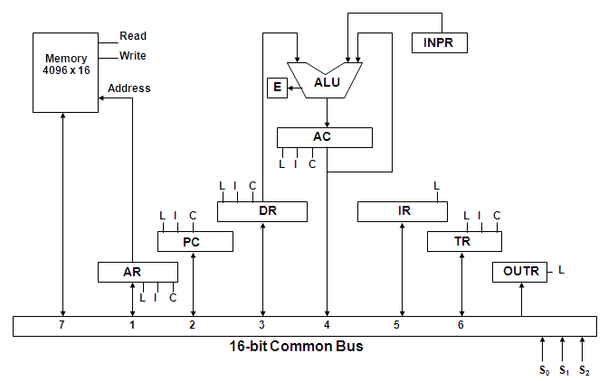
COMMON BUS SYSTEM
The registers in the Basic Computer are connected using a bus
This gives a savings in circuitry over complete connections between registers
Course Code: CS E212
Semester: III

Slide 12
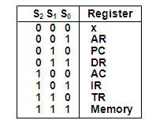
Three control lines, S₂, S₁, and S₀ control which register the bus selects as its input
Either one of the registers will have its load signal activated, or the memory will have its read signal activate will determine where the data from the bus gets loaded
12-bit registers, AR and PC, have 0’s loaded onto the bus in the high order 4 bit positions
When the 8-bit register OUTR is loaded from the bus, the data comes from the low order 8 bits on the bus
Course Code: CS E212
Semester: III

Slide 13
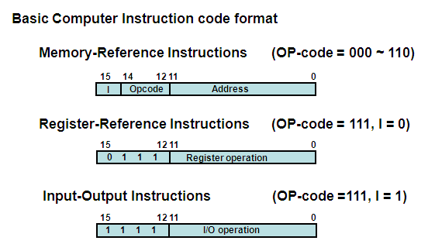
Computer Instructions
Course Code: CS E212
Semester: III

Slide 14
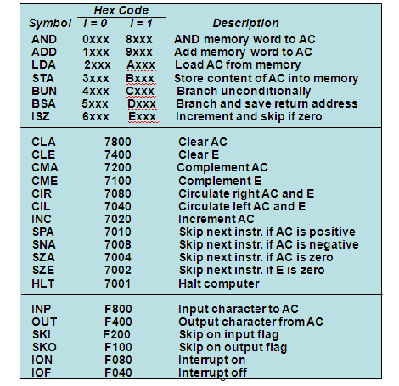
Course Code: CS E212
Semester: III

Slide 15
INSTRUCTION SET COMPLETENESS
Instruction Types
  Functional Instructions
  - Arithmetic, logic, and shift instructions
  - ADD, CMA, INC, CIR, CIL, AND, CLA (other than ADD/AND?)
  Transfer Instructions
  - Data transfers between the main memory and the processor registers
  - LDA, STA
  Control Instructions
  - Program sequencing and control
  - BUN, BSA, ISZ
  Input/Output Instructions
  - Input and output
  - INP, OUT
Course Code: CS E212
Semester: III

Slide 16
CONTROL UNIT
Control unit (CU) of a processor translates from machine instructions to the control signals (for the microoperations) that implement them.
Control units are implemented in one of two ways
Hardwired Control
  CU is made up of sequential and combinational circuits to generate the control signals
Microprogrammed Control
  A control memory on the processor contains microprograms that activate the necessary control signals
We will consider a hardwired implementation of the control unit for the Basic Computer
Course Code: CS E212
Semester: III

Slide 17
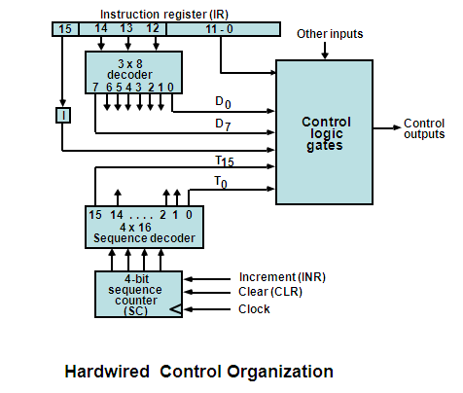
TIMING AND CONTROL
Course Code: CS E212
Semester: III

Slide 18
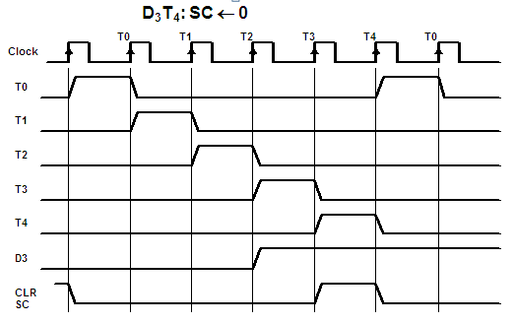
TIMING SIGNALS
Generated by 4-bit sequence counter and 4×16 decoder
- The SC can be incremented or cleared.
- Example: T₀, T₁, T₂, T₃, T₄, T₀, T₁, . . .
Assume: At time T₄, SC is cleared to 0 if decoder output D3 is active.
Course Code: CS E212
Semester: III

Slide 19
Basic Computer, a machine instruction is executed in the following cycle
  Fetch an instruction from memory
  Decode the instruction and calculate effective address (EA)
  Read the EA from memory if the instruction has an indirect address
  (Fetch operand)
  4. Execute the instruction
After an instruction is executed, the cycle starts again at step 1, for the next instruction
Note: Every different processor has its own (different) instruction cycle
INSTRUCTION CYCLE
Course Code: CS E212
Semester: III

Slide 20
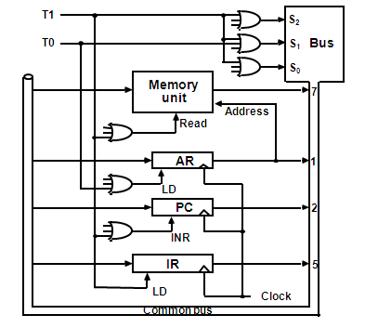
FETCH and DECODE
Course Code: CS E212
Semester: III
T0: AR ← PC (S₂S₁S₀=010, T0=1)
T1: IR ← M [AR], PC ← PC + 1 (S₂S₁S₀=111, T1=1)
T2: D0, . . . , D7 ← Decode IR(12-14), AR ← IR(0-11), I ← IR(15)

Slide 21
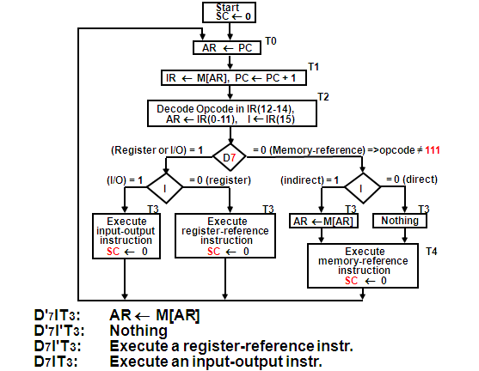
DETERMINE THE TYPE OF INSTRUCTION
Course Code: CS E212
Semester: III

Slide 22
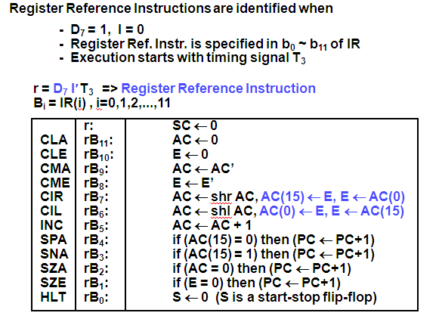
REGISTER REFERENCE INSTRUCTIONS
Course Code: CS E212
Semester: III

Slide 23
Course Code: CS E212
Semester: III

Slide 24
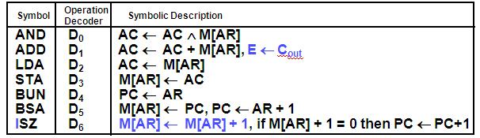
MEMORY REFERENCE INSTRUCTIONS
Course Code: CS E212
Semester: III
Effective address of the instruction is in AR and was placed there during timing signal T₂ when I = 0, or during timing signal T₃ when I = 1.
  - Memory cycle is assumed to be short enough to complete in a CPU cycle
  - The execution of MR instruction starts with T₄
AND to AC
D₀T₄: DR ← M[AR] Read operand
D₀T₅: AC ← AC ∧ DR, SC ← 0 AND with AC
ADD to AC
D₁T₄: DR ← M[AR] Read operand
D₁T₅: AC ← AC + DR, E ← C_{out}, SC ← 0 Add to AC and store carry in E

Slide 25
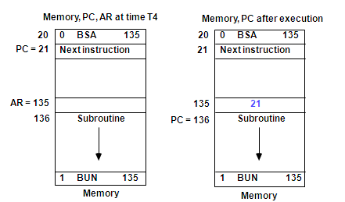
MEMORY REFERENCE INSTRUCTIONS
LDA: Load to AC
D₂T₄: DR ← M[AR]
D₂T₅: AC ← DR, SC ← 0
STA: Store AC
D₃T₄: M[AR] ← AC, SC ← 0
BUN: Branch Unconditionally
D₄T₄: PC ← AR, SC ← 0
BSA: Branch and Save Return Address
Course Code: CS E212
Semester: III

Slide 26
Course Code: CS E212
Semester: III
MEMORY REFERENCE INSTRUCTIONS
BSA:
D₅T₄: M[AR] ← PC, AR ← AR + 1
D₅T₅: PC ← AR, SC ← 0
ISZ: Increment and Skip-if-Zero
D₆T₄: DR ← M[AR]
D₆T₅: DR ← DR + 1
D₆T₆: M[AR] ← DR, if (DR = 0) then (PC ← PC + 1), SC ← 0

Slide 27
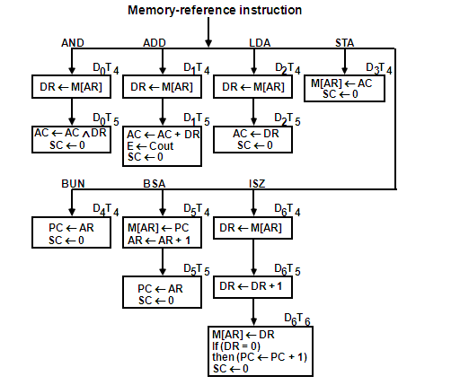
FLOWCHART FOR MEMORY REFERENCE INSTRUCTIONS
Course Code: CS E212
Semester: III

Slide 28
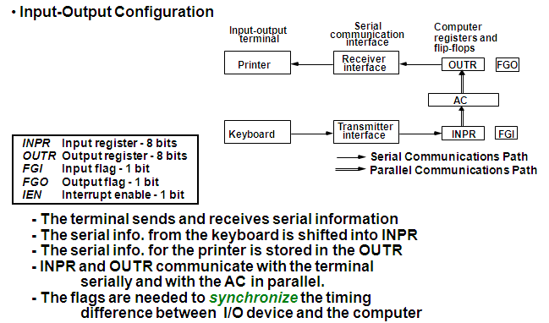
INPUT-OUTPUT AND INTERRUPT
Course Code: CS E212
Semester: III

Slide 29
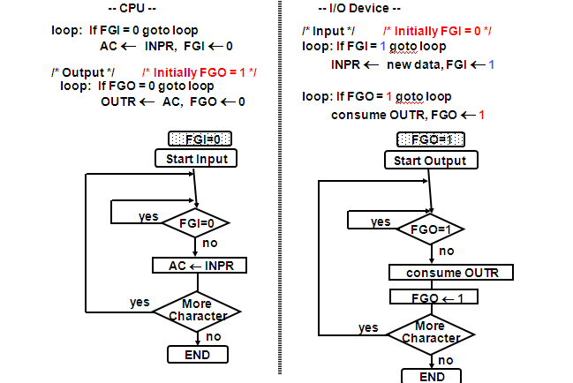
PROGRAM CONTROLLED DATA TRANSFER
Course Code: CS E212
Semester: III

Slide 30
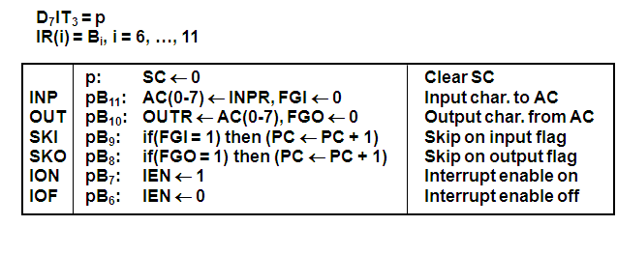
INPUT-OUTPUT INSTRUCTIONS
Course Code: CS E212
Semester: III

Slide 31
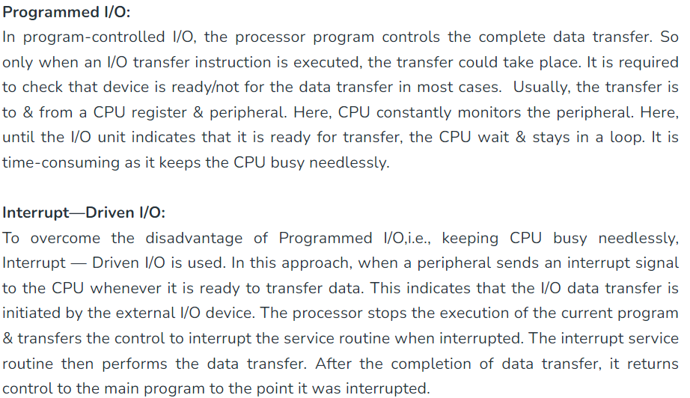
Course Code: CS E212
Semester: III

Slide 32
PROGRAM-CONTROLLED INPUT/OUTPUT
Course Code: CS E212
Semester: III
Program-controlled I/O
Continuous CPU involvement
I/O takes valuable CPU time
- CPU slowed down to I/O speed
- Simple
- Least hardware
Input
LOOP SKI DEV
BUN LOOP
INP DEV
Output
LDA DATA
LOOP SKO DEV
BUN LOOP
OUT DEV

Slide 33
INTERRUPT INITIATED INPUT/OUTPUT
Course Code: CS E212
Semester: III
- Open communication only when some data has to be passed --> interrupt.
- The I/O interface, instead of the CPU, monitors the I/O device.
- When the interface founds that the I/O device is ready for data transfer, it generates an interrupt request to the CPU
- Upon detecting an interrupt, the CPU stops momentarily the task it is doing, branches to the service routine to process the data transfer, and then returns to the task it was performing.
* IEN (Interrupt-enable flip-flop)
- can be set and cleared by instructions
- when cleared, the computer cannot be interrupted

Slide 34
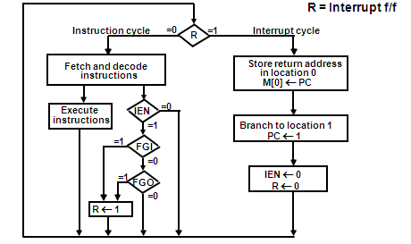
FLOWCHART FOR INTERRUPT CYCLE
Course Code: CS E212
Semester: III
The interrupt cycle is a HW implementation of a branch
and save return address operation.
- At the beginning of the next instruction cycle, the
instruction that is read from memory is in address 1.
- At memory address 1, the programmer must store a branch instruction
that sends the control to an interrupt service routine
- The instruction that returns the control to the original
program is "indirect BUN 0"

Slide 35
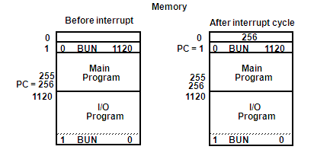
REGISTER TRANSFER OPERATIONS IN INTERRUPT CYCLE
Course Code: CS E212
Semester: III
Register Transfer Statements for Interrupt Cycle
- R F/F ← 1 if IEN (FGI + FGO)T₀′T₁′T₂′
⇔ T₀′T₁′T₂′ (IEN)(FGI + FGO): R ← 1
- The fetch and decode phases of the instruction cycle
must be modified ➔Replace T₀, T₁, T₂ with R'T₀, R'T₁, R'T₂
- The interrupt cycle :
RT₀: AR ← 0, TR ← PC
RT₁: M[AR] ← TR, PC ← 0
RT₂: PC ← PC + 1, IEN ← 0, R ← 0, SC ← 0

Slide 36
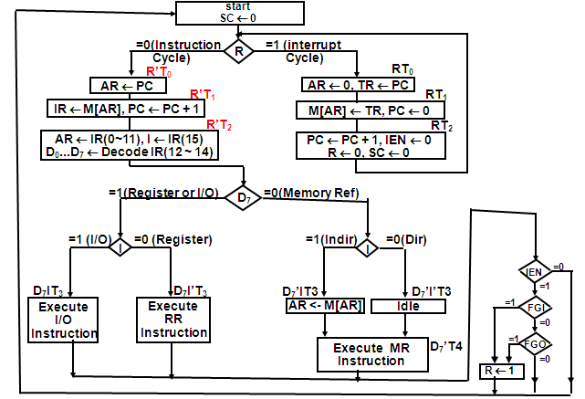
COMPLETE COMPUTER DESCRIPTION
Flowchart of Operations

Slide 37
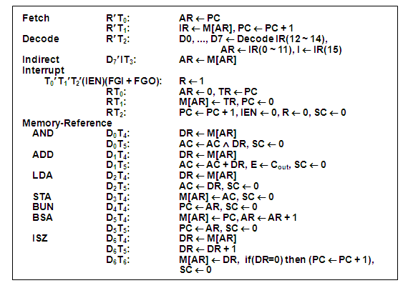
COMPLETE COMPUTER DESCRIPTION Microoperations

Slide 38
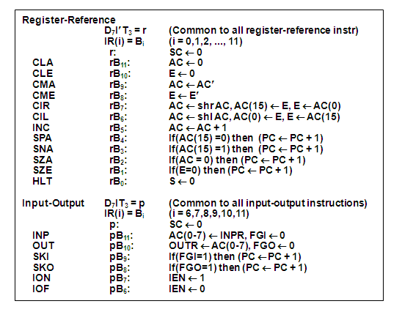
COMPLETE COMPUTER DESCRIPTION Microoperations

Slide 39
DESIGN OF BASIC COMPUTER(BC)
Course Code: CS E212
Semester: III
Hardware Components of BC
A memory unit: 4096 x 16.
Registers:
AR, PC, DR, AC, IR, TR, OUTR, INPR, and SC
Flip-Flops(Status):
I, S, E, R, IEN, FGI, and FGO
Decoders: a 3x8 Opcode decoder
a 4x16 timing decoder
Common bus: 16 bits
Control logic gates:
Adder and Logic circuit: Connected to AC
Control Logic Gates
  - Input Controls of the nine registers
  - Read and Write Controls of memory
  - Set, Clear, or Complement Controls of the flip-flops
  - S₂, S₁, S₀ Controls to select a register for the bus
  - AC, and Adder and Logic circuit

Slide 40
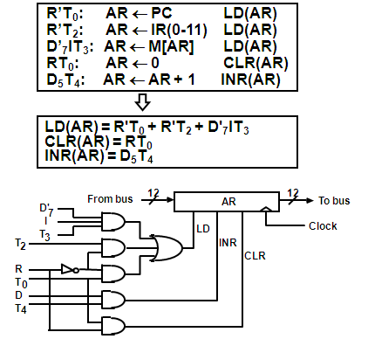
CONTROL OF REGISTERS AND MEMORY
Course Code: CS E212
Semester: III
Address Register; AR
Scan all of the register transfer statements that change the content of AR:

Slide 41
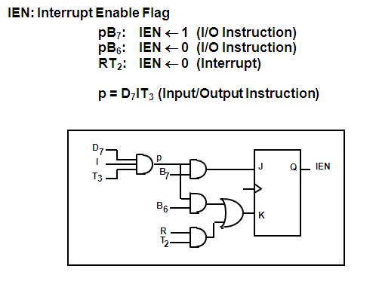
CONTROL OF FLAGS
Course Code: CS E212
Semester: III

Slide 42
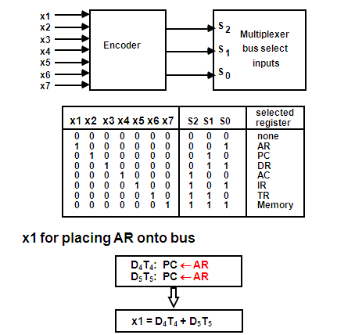
CONTROL OF COMMON BUS
Course Code: CS E212
Semester: III

Slide 43
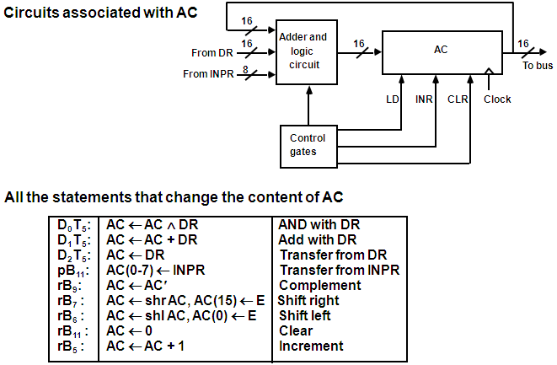
DESIGN OF ACCUMULATOR LOGIC
Course Code: CS E212
Semester: III

Slide 44
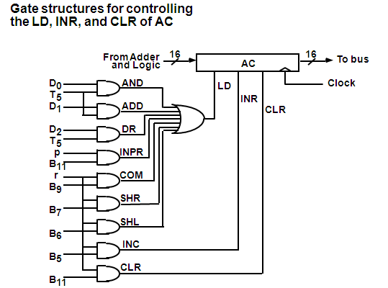
CONTROL OF AC REGISTER
Course Code: CS E212
Semester: III

Slide 45
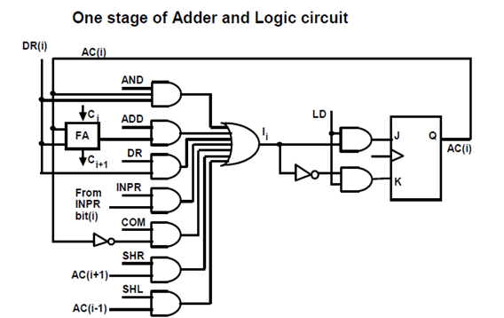
ALU (Adder & Logic Circuits)
Course Code: CS E212
Semester: III

